Slide 1
Baylor x Credera: Software Engineering II
Fall 2022
Notes:
GD

Slide 2
Introductions
Expectations
Project Overview
Mentor/Team Collaboration
Technology Stack
Template Project Walkthrough
Questions
Notes:
GD

Slide 3


OUR TEAM
Garrett Dorr
Senior Consultant, Technology Solutions
Garrett Dorr is a Senior Consultant in the Technology Solutions Practice at Credera's Dallas office. He graduated from Baylor University with a Bachelor of Business Administration in Management Information Systems. His technical experience includes Java, JavaScript, TypeScript, Angular, and Spring Boot. He has worked for three years developing a web-based application for C Spire.
I love to cook, my favorite dish I've ever made before is Shrimp Scampi. Completely unrelated but one time I got to pet and feed a giraffe at the Fort Worth Zoo.
Logan Parmeter
Senior Consultant, Technology Solutions
Logan Parmeter is a Senior Consultant in the Technology Solutions practice at Credera. She graduated with a BS in Computer Science from Baylor University in 2019. Logan has experience using various technologies including C, C++, Java, ReactJS, Swift, SwiftUI, Spring, Objective C, Kotlin, and Google Firebase. She has worked on various mobile applications at Brinker International, Handy, Angi, and Hilton.
In my free time, I enjoy crafting (sewing, knitting, crochet, drawing, etc.) and listening to audiobooks. I'm currently listening to the Star Wars Legends books.

Slide 4
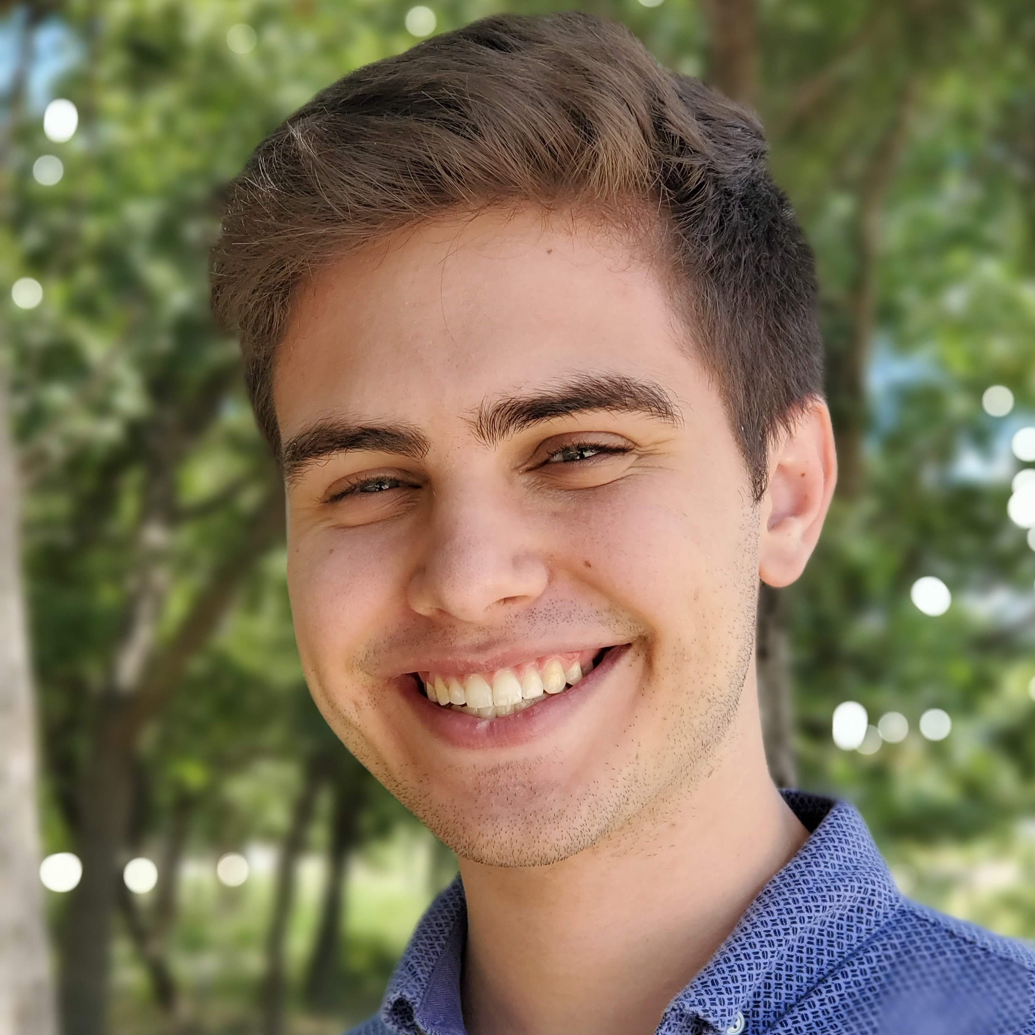
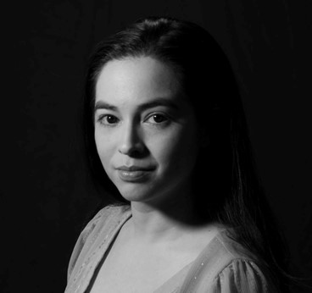
OUR TEAM
Thomas Mello
Consultant, Technology Solutions
Thomas Mello is a Consultant in the Technology Solutions practice at Credera in the Dallas office. He graduated with a BS in Electrical & Computer Engineering from Baylor University in 2021. Thomas has experience using various technologies including C, C++, Java, JavaScript, ReactJS, VueJS, SwiftUI, and Google Cloud Platform. He has worked on various mobile and web applications at Angi.
I love to rock climb and play video games with friends. During my time at Baylor, I was the Executive Producer for Sing.
Christina Flores
Senior Consultant, Technology Solutions
Christina is a Senior Consultant in the Technology Solutions Practice at Credera's Dallas office. She graduated from Baylor University with a Bachelor of Science in Informatics. Her technical experience includes Java, C++, JavaScript, TypeScript, Angular, React, React Native, Vue, Flutter and Spring Boot. She has worked for five years at Credera, working on web-based application for C Spire, IFM Restoration, Liberty Oilfield, Orthorix, and Handy.
I was a member of Baylor Latin Dance Society during college and am working as a part time instructor for the Bailart Dance team in the Dallas area.

Slide 5
EXPECTATIONS
This semester, students are expected to embrace the role of a consultant on a real world project, working with mentors to define, develop, and implement the product
Student Expectations
Students should expect to face a real-world situation. Mentors will be product owners as well as technical advisors
Not every decision can be made by the mentors, many times it is up to the group to decide. Mentors are there to provide feedback and suggestions
Students should expect to learn technologies on their own. This is something that would be expected of you on a real project. Mentors will help answer specific questions, but come prepared
Mentors expect students to come prepared with specific questions that could be answered in office hours. Make sure they are clear and concise rather than vague or general
Notes:
CF

Slide 6
PROJECT OVERVIEW
A new company, TrailBlazers, Inc., wants to create a custom experience for road trippers everywhere, so they can plan their route for optimized efficiency and fun
PROJECT DESCRIPTION
The application will allow road trippers to plan their road trips
They want an intuitive user experience coupled with powerful functionality
Your team has been given until the end of November to develop the application
PROJECT PLAN
AUGUST | SEPTEMBER | OCTOBER | NOVEMBER | DECEMBER
MILESTONE 1
(Week of 9/19)
Thanksgiving
Project Kickoff
(8/30)
Setup team repository
Scaffold out pages with routing
Call example Java endpoint from client
MILESTONE 2
(Week of 10/10)
Sign in, registration, profile, and home page
Create a new journey and add start and stop destinations
Automated Testing
Deploy template project to GCP
Set up continuous integration
MILESTIONE 3
(Week of 11/7)
Suggestions for stops related to preferences and journey details
Reminders before and during trip
Rating the stops during and after the trip
MILESTONE 4
Due at Final Presentation
(12/6)
Security
Final UX
Bonus features
Notes:
TM

Slide 7
MENTOR/TEAM COLLABORATION
Collaborating between mentors and teams will occur through a messaging board and weekly scrum meetings
Contact
Collaboration will primarily occur through message boards (Piazza)
Weekly scrum meetings will take place sometime on Monday or Tuesday evenings
Each team will have a 20-minute slot between 5:20-6:00PM on Monday and 6:00-6:40PM on Tuesday
Each team should have questions ready (i.e., requirements, Spring, APIs) to discuss during the meeting for further understanding
Review and discuss any artifacts (attach artifacts to messages at least the day before the scrum so the mentor has time to review)
Provide a brief demo of new functionality
Best Practices
Come prepared to all meetings and scrums
If you must miss a meeting, send the mentors your updates prior to the meeting
Notes:
TM

Slide 8
Technology Stack

Slide 9


TECHNOLOGY STACK
This semester your team will be using several technologies to build out the web app including Spring, REST, React, and MySQL
Architecture Overview
Data Storage
Server Side
Client Side
Notes:
Garrett
Delineates where data lives
Communicates through REST APIs

Slide 10
TECHNOLOGY STACK
This semester your team will be using several technologies to build out the web app including Spring, REST, React, and MySQL
SPRING
What is it?
Spring (aka Spring Framework) is an open source framework and inversion of control container for Java that was created to address the complexity of developing enterprise applications
Spring has layered architecture that allows developers to leverage certain components while not utilizing others that they may not care about
Why are we using it?
Spring has become a popular replacement for Enterprise JavaBean (EJB)
How are we using it?
Spring allows for easy integration with other useful technologies and frameworks
Notes:
GD

Slide 11
TECHNOLOGY STACK
This semester your team will be using several technologies to build out the web app including Spring, REST, React, and MySQL
REST API
What is it?
Representational state transfer (REST) is an architecture that consists of a coordinated set of constraints that applies to components, connectors, and data elements
The REST architecture has been applied to developing web services and is commonly used as an alternative to SOAP
REST allows for data to be quickly obtained via point-to-point communications with clients
Why are we using it?
In order to retrieve and manipulate the data, we need to implement REST
How are we using it?
For this project, REST will be used to store and retrieve data about profiles
Notes:
GD

Slide 12
TECHNOLOGY STACK
This semester your team will be using several technologies to build out the web app including Spring, REST, React, and MySQL
REACT
What is it?
React is a JavaScript framework that extends HTML to allow for dynamic HTML pages
Why are we using it?
React is open-source and allows for the creation of modern single-page-applications
It provides some advanced features like components and routing
JavaScript is the industry standard for web development
How are we using it?
React will be used to render all of your HTML
Whenever you do any custom styling of the UI we have provided in the template project, you will be working with React/HTML/CSS
Notes:
TM

Slide 13
TECHNOLOGY STACK
This semester your team will be using several technologies to build out the web app including Spring, REST, React, and MySQL
Mysql
What is it?
MySQL is a popular open-source relational database management system
Why are we using it?
Fast and reliable
Provides official Docker images maintained by the MySQL team for Linux platforms
MySQL is leading choice for SQL databases and is used in a wide variety of applications
How are we using it?
MySQL will be the data store for this project
All information about profiles and trips will be stored in and retrieved from MySQL
Notes:
TM

Slide 14
TECHNOLOGY STACK
This semester your team will be using several technologies to build out the web app including Spring, REST, React, and MySQL
Architecture Overview
Data Storage
Server Side
Client Side
Notes:
John

Slide 15
Template Project Walkthrough
Notes:
Files
Front end and backend lay of the land/directory level (GD, LP)

Slide 16
Questions?

